Slide 1
Pathology of CNS infections
Dr Durga Moratuwagama
Department of Pathology

Slide 2
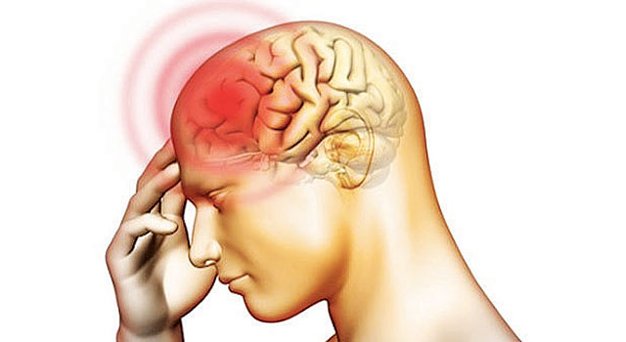
Can brain its covering get infected?

Slide 3

At the end of this lecture you should be able to;
List the routes of CNS infections
Classify CNS infections
Describe the macroscopy and microscopay of acute bacterial meningitis
Describe the macroscopy and microscopay of other CNS infcetions
Describe the complications of CNS infections

Slide 4
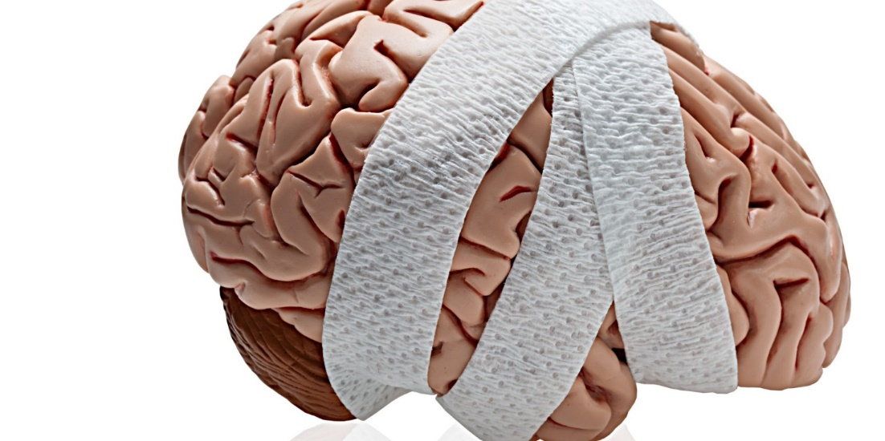
Direct
In direct
Toxins
Immunological reaction
Inflammatory response

Slide 5


Slide 6
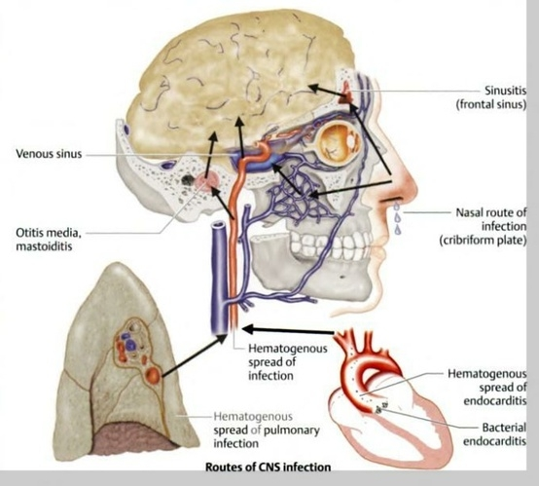
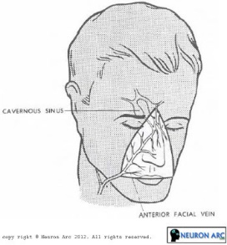

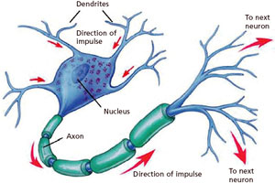
Direct trauma
Rabies
HZ

Slide 7
Infections of the CNS
Meningitis -diffuse inflammation of the meninges
Encephalitis -inflammation of the brain matter
Meningo-enchephalitis
Cerebral abscess –focal suppuration of brain matter
Other inflammatory lesions
Epidural abscess
Subdural empyema
Septic thromboembolism of dural sinuses
encephalomyelitis

Slide 8
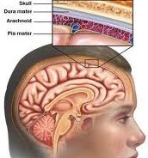
Meningitis
Diffuse inflammation of the meninges
Inflammation of the dura- pachymeningitis
Inflammation of pia-arachnoid –leptomeningitis
By convention “meningitis” means leptomeningitis

Slide 9
Meningitis (leptomeningitis)
Acute bacterial meningitis
Chronic meningitis caused by tuberculosis and fungi
Asceptic meningitis/ viral meningitis
Infrequently meningitis may caused by
Chemicals -chemical meningitis
Malignant cell infiltration -carcinomatous meningitis

Slide 10
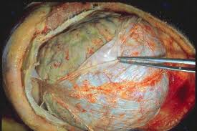
Acute bacterial meningitis
Acute infection of pia-arachnoid and the CSF enclosed within the subarachnoid space
Spread to the ventricles/ brain substance

Slide 11

Commonest organisms
Refer Microbiology

Slide 12
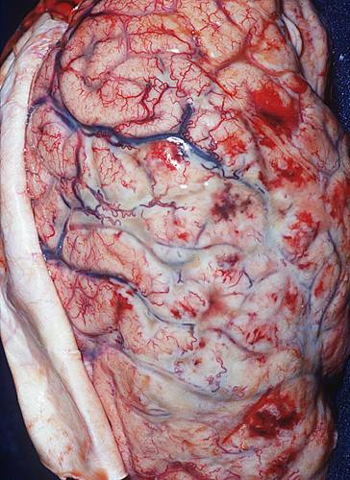
Acute bacterial meningitis - Macroscopy
Oedema of the brain
Inflammatory exudate (pus) fills the subarachnoid space
Clear CSF becomes turbid
Meninges looks opaque
The sulci are filled with pus
Vessels are prominent
Changes are more marked on the base of the brain.

Slide 13
The layer of pus organizes and cause fibrous adhesions
This can result in compression of cranial nerves and hydrocephalus.
Phlebitis-venous occlusion/haemorrhagic infarctions

Slide 14
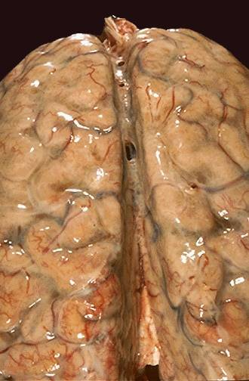
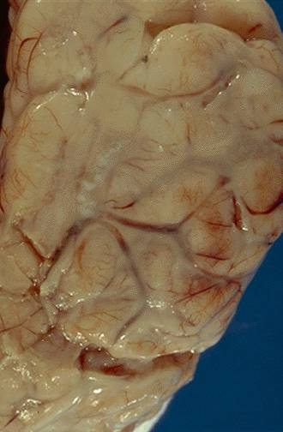
The yellow-tan exudate of acute bacterial meningitis seen here obscures the sulci

Slide 15
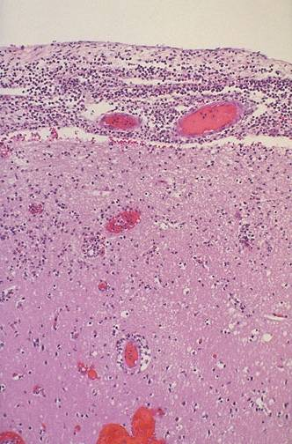
Acute bacterial meningitis - Microscopy
Acute inflammatory exudate containing many neutrophils in the subarachnoid space and in the meninges.
Prominent dilated vessels

Slide 16
Viral/ aseptic meningitis
Also known as acute lymphocytic meningitis
Aetiology -various viruses
Enterovirus
ECHO
Coxsackie
Mumps
Epstein-Barr
HSV
HIV
Haematogenous spread

Slide 17
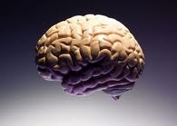
Viral/ septic meningitis
Morphological changes are not so marked as in bacterial meningitis
Microscopically there is mild lymphocytic infiltrate in the leptomeninges.

Slide 18
Chronic meningitis. Tuberculous meningitis
Routes of spread
Haematogenous
As a part of milliary tuberculosis
Less commonly direct spread from TB of verteral body

Slide 19
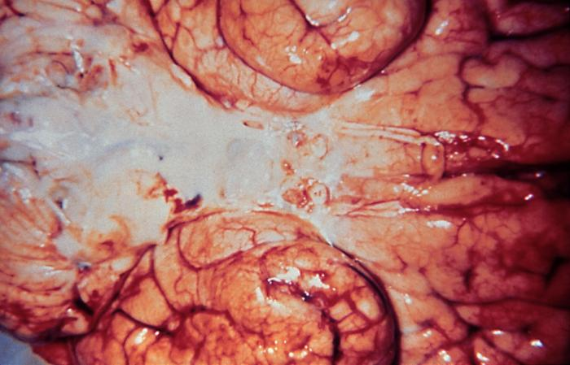
Tuberculous meningitis -macroscopy
Sub arachnoid space-gelatinous/fibrinous exudate
Thick exudate obscuring the sulci particularly at the base of the brain.
Obliterate cistern/encase cranial nerves
Tubercles of 1-2 mm mainly closer to the blood vessels.
Adhesions are invariable

Slide 20
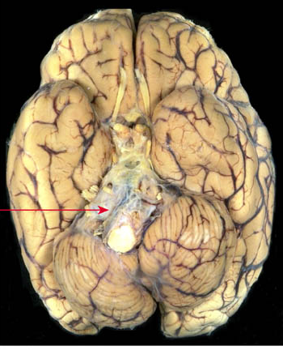
Thick grey exudate encasing the cranial nerves and blood vessels

Slide 21
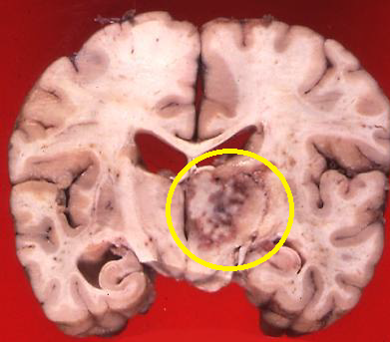
Tuberculoma

Slide 22
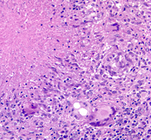
Tuberculous meningitis -microscopy
Chronic inflammatory cell infiltrate
Few neutrophils may be seen
Granuloma formation with giant cell
With or without caseation
Obliterative endarteritis
When the treatment is delayed fibrous adhesions in the subarachnoid space.

Slide 23
Fungal meningitis
Mainly in debilitated or immunocompromized patients
An important cause for meningitis in HIV/AIDS
Haematogenous spread from infections at distant sites
Organisms
Cryptococcus neoformans
Candida albicans
Coccidioides immitis
Aspergillus

Slide 24
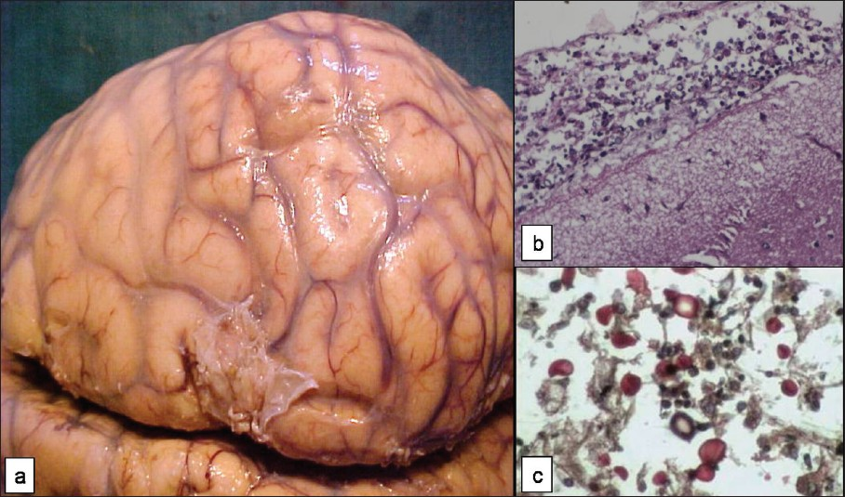
Fungal meningitis
lymphomononuclear inflammation over meninges with scattered yeast like fungal organisms
Brain showing opaque meninges in cryptococcal meningitis
yeast like forms of Cryptococcus highlighted by mucicarmine stain

Slide 25

Complications?

Slide 26
CSF findings in different types meningitis
Feature | Normal | Bacterial meningitis | Viral meningitis | Tuberculous meningitis
Naked eye appearance | Clear/colourless | Cloudy/purulent | Clear /turbid | Turbid/viscous Fibrin coagulum on standing (cob-web)
Cells /mm³ | 0-4 Ly 0 N | 200-thousands N <50 Ly | 10-100 Ly 0 N | 100-300 Ly 0-200 N
Proteins | 15-45 mg/dl | Markedly raised | Raised | Raised
Glucose | 2/3-1/2 blood glucose | <1/2 blood glucose | >1/2 blood glucose | <1/2 blood glucose
Bacteriology | sterile | Causative organism + | sterile | TB bacilli

Slide 27
Encephalitis
Diffuse parenchymal infection of the brain
Viral
Bacterial
Fungal -Candida, Cryptococcus,
Histoplasma,
Mucor, Blastomyces
Protozoal –malaria, toxoplasma,
amoeba,cysticerca
Common in immunocompromized and in patients with lymphomas and other cancers

Slide 28
Viral encephalitis
Most viral infections of CNS are the result of preceding viral proliferation in some other site.
Eg alimentary tract, skin or mucus membranes
Viruses enter by different routes
Oral –enteroviruses
skin -herpes
placenta -CMV
body fluids- HIV
They reach the brain via
Blood
Peripheral nerves -rabies

Slide 29
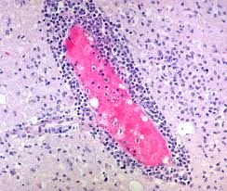
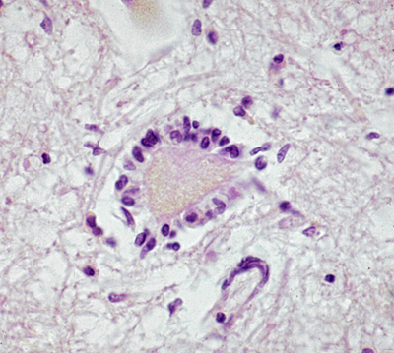
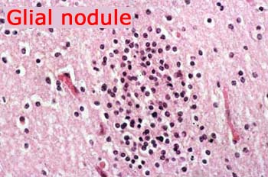
Viral encephalitis
Mononuclear cell infiltrate , mainly around blood vessels (Lymphocytes, plasma cells , macrophages)
Microscopic clusters of microglia
Neuronophagia

Slide 30
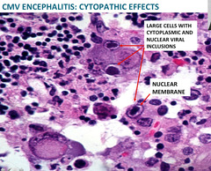
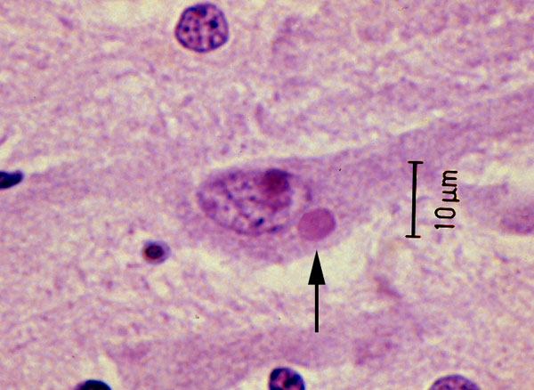
Specific cellular changes depending on the causative virus
Negri body- rabies Intranuclear inclusions - HSV,CMV

Slide 31
Brain abscess
Acute focal suppurative infection of the brain matter
Routes of spread
Direct implantation of organisms
Local extension
Haematogenous
Predisposing factors
Acute bacterial endocarditis
Cyanotic heart diseases with R-L shunts
Chronic pulmonary sepsis

Slide 32
Brain abscess- morphology
Well defined , focal lesions with central necrosis
Surrounded by a fibrous capsule
Brain oedema
Common sites - frontal and parietal lobes, cerebellum
Effects of a space occupying lesion- refer
Microscopy
Central liquefactive necrosis
Neovascularization surrounding the necrotic centre
Reactive gliosis

Slide 33
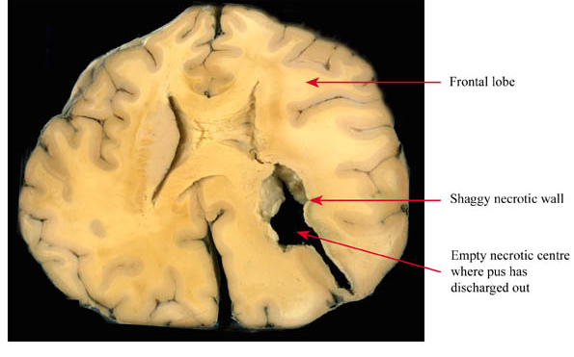
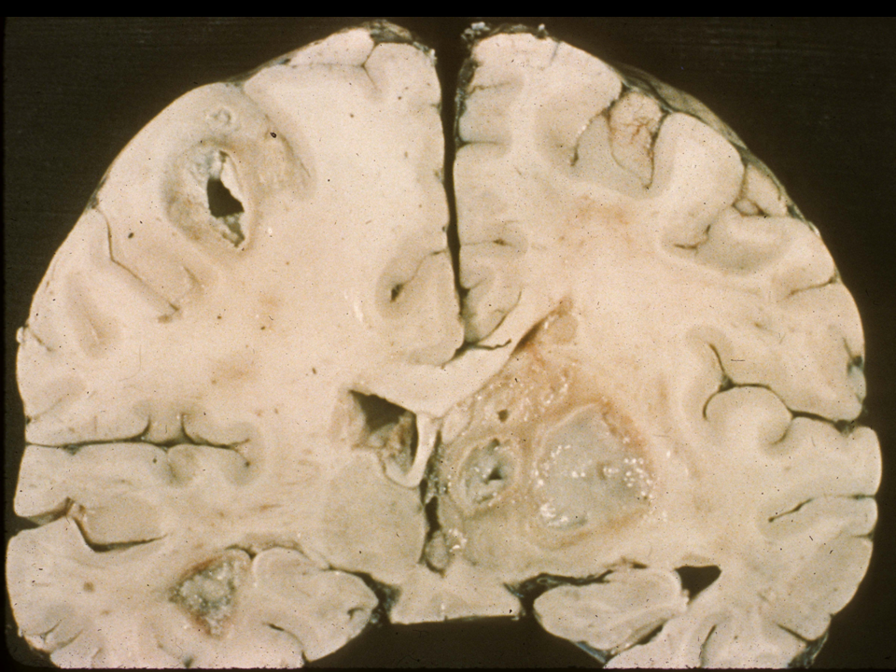
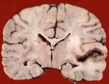

Slide 34
Summary
CNS infections can be due to various organisms
Organisms reach brain via various routes
Acute Bacterial Meningitis – Marked macroscopic and microscopic changes
Leads to complications

Slide 35
Read on…………….
Arthropode borne (arbo) viral enchephalitis
HSV and CMV enchephalitis
Poliomyelitis
Rabies
HIV associated nervous system pathology
Slow virus infections/ Prion diseases
Reference: Pathologic basis of disease -Robbins

